Slide 1
Mock Test & Exam Management System
Ansh Mehta – 32
Anish Charak – 07
Adwait Jedhe – 23

Slide 2
Problem Definition
Make a mini project which helps teachers in evaluating their students and helps students to prepare for their examination.

Slide 3
Introduction
This mini project is developed with an aim of assisting the teachers and students.
Examination being a significant part of our education should be taken seriously and students should prepare for it properly.
This project will help students prepare for their examinations and will help them gain confidence for facing the difficult questions and the pressurized examination environment.

Slide 4
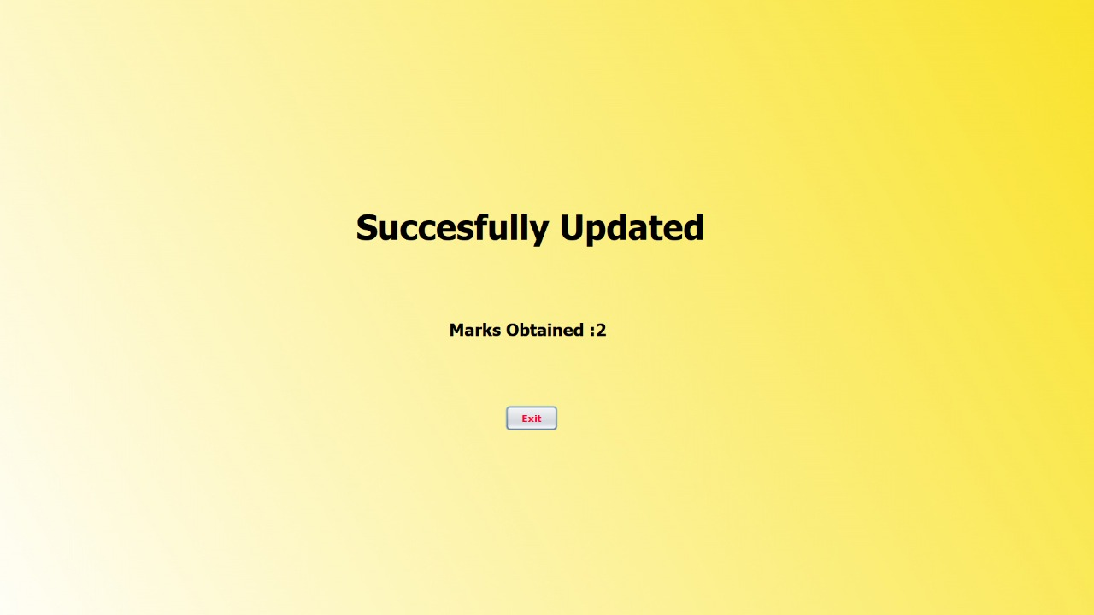
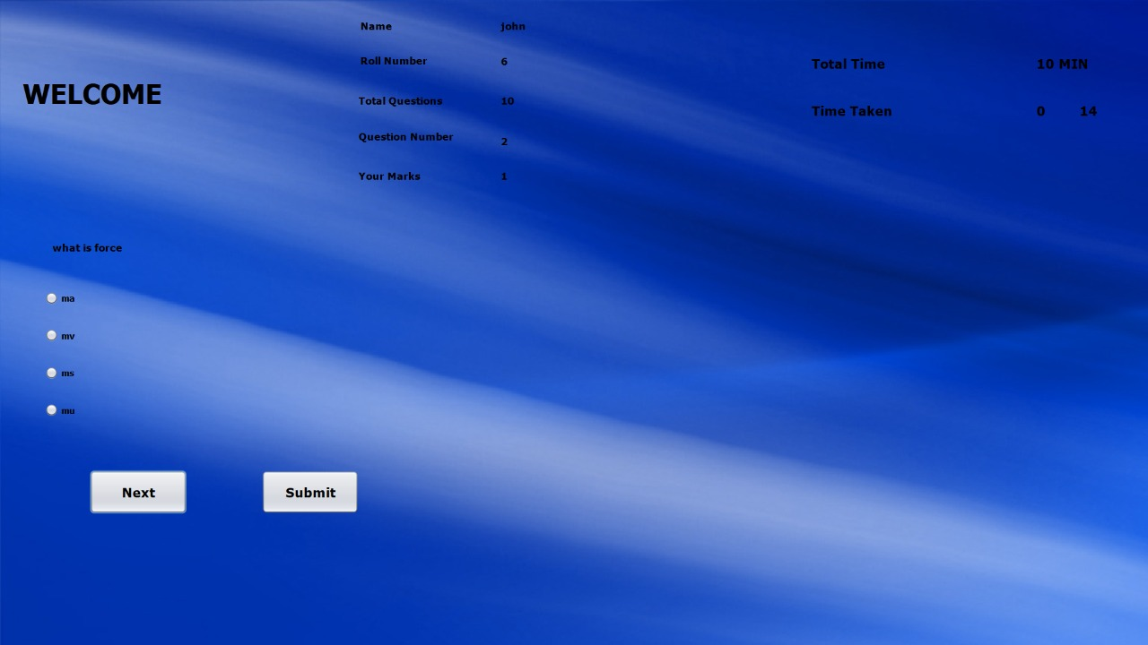
Scopes
Student and Admin Login Page.
Questions are to be solved in stipulated time.
Different functionalities for student and admin.
An interactive UI will grasp students’ interest.

Slide 5
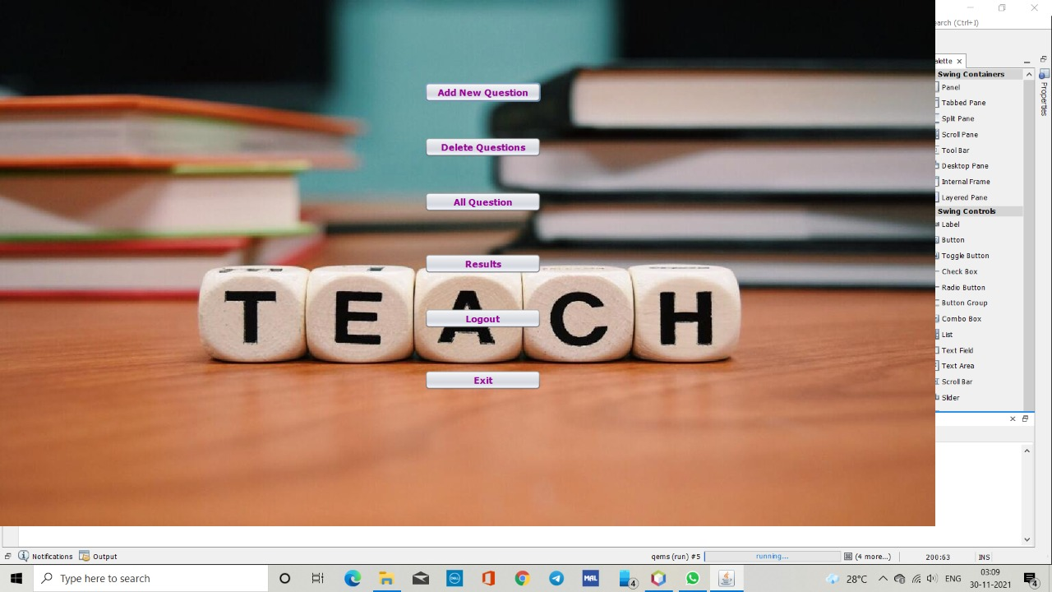
Scopes
Teacher can add new questions.
Added questions can be updated and deleted whenever required.
Teacher can feed the answer for the question in system only.
Results of students can be viewed by the teacher and the student examination data can be sorted by the teacher as they want.

Slide 6
How will it help?
Students will get the result just after the completion of exam. So, they do not have to wait for their results and can work on their wrong answers.
A timer will not let student’s focus to get diverted. Moreover, a timer will also demand quick solving which will force the students to find efficient ways to solve the same problem.
Teachers can sort and organize student data easily. Student data can be easily stored and accessed.
Students can prepare for their examination irrespective of their location.
Students get to practice and teachers can give homework to students via this project. Its an all-in-one project.

Slide 7
Future Scope
Artificial Intelligence can be used to make this project more user-friendly and keeping track of student data.
User Interface can be updated as per end-user requirements.
The database can be hosted on an online server and the application prototype can be put on Google Play Store.
New features can be added as per user requirements.

Slide 8
Conclusion
Students will find it extremely useful for their “Exam-Prep”.
While helping students it will also lessen the burden of teachers to get all the students together in a place and supervise the proper conduction of examination.

Slide 9
Thank You!

